Slide 1

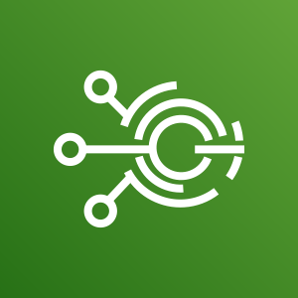








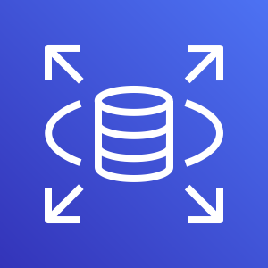
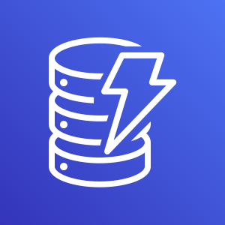






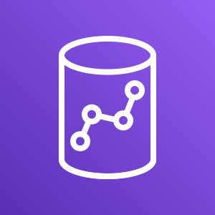
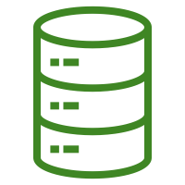








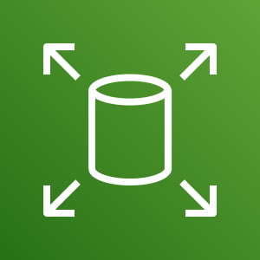







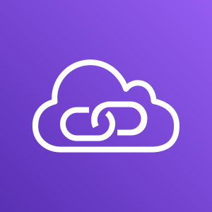


The Databricks Unified Data Analytics Platform
Data Ingestion
Data Engineering
Serving Layer
Analytics
Streaming Data
Customer VPC
Model Serving
AWS
IoT Events
Amazon
SageMaker
Amazon Kinesis
Operational Databases
Applications
Messages
Spot
instance
Amazon
API Gateway
Amazon
RDS
Amazon
DynamoDB
G3 instance
Unified Data Analytics Platform
Batch Data
BI Tools
Files
Amazon S3
Amazon Redshift
Data store
Amazon S3 Glacier
Amazon S3
AWS Glue
Amazon
Athena
AWS
IAM
AWS
CloudFormation
AWS
CloudTrail
Amazon
CloudWatch
AWS
Config
Amazon
EBS
Amazon
ECR
AWS
KMS
AWS
SNS
AWS
SQS
AWS
SSO
AWS CodePipeline
Amazon
MSK
AWS
PrivateLink
AWS Services

Slide 2
Batch Data Pipelines
Analytics
Data Ingestion
Analytics
Data Ingestion
Data Engineering
Data Engineering
Serving Layer
Serving Layer
Streaming Data
Customer VPC
Streaming Data
Model Serving
Model Serving
AWS
IoT Events
AWS
IoT Events
Amazon
SageMaker
Amazon
SageMaker
Amazon Kinesis
Amazon Kinesis
Operational Databases
Operational Databases
Applications
Applications
Messages
Messages
Spot
instance
Spot
instance
Amazon
DynamoDB
Amazon
API Gateway
Amazon
DynamoDB
Amazon
API Gateway
Amazon
RDS
G3 instance
Amazon
RDS
G3 instance
Unified Data Analytics Platform
Batch Data
Batch Data
BI Tools
BI Tools
Files
Files
Amazon S3
Amazon S3
Amazon Redshift
Amazon Redshift
Data store
Data store
AWS Glue
Amazon S3 Glacier
AWS Glue
Amazon S3 Glacier
Amazon
Athena
Amazon S3
Amazon
Athena
Amazon S3
AWS
CloudFormation
AWS
CloudFormation
Amazon
MSK
Amazon
MSK
AWS
PrivateLink
AWS
IAM
AWS
PrivateLink
AWS
IAM
Amazon
ECR
Amazon
CloudWatch
Amazon
ECR
AWS
CloudTrail
Amazon
CloudWatch
AWS
CloudTrail
AWS
Config
AWS
Config
Amazon
EBS
Amazon
EBS
AWS
SQS
AWS
SNS
AWS
SQS
AWS
SNS
AWS CodePipeline
AWS
KMS
AWS CodePipeline
AWS
KMS
AWS
SSO
AWS
SSO
AWS Services
AWS Services

Slide 3
Streaming Data Pipelines
Analytics
Data Ingestion
Analytics
Data Ingestion
Data Engineering
Data Engineering
Serving Layer
Serving Layer
Streaming Data
Customer VPC
Streaming Data
Model Serving
Model Serving
AWS
IoT Events
AWS
IoT Events
Amazon
SageMaker
Amazon
SageMaker
Amazon Kinesis
Amazon Kinesis
Operational Databases
Operational Databases
Applications
Applications
Messages
Messages
Spot
instance
Spot
instance
Amazon
DynamoDB
Amazon
API Gateway
Amazon
DynamoDB
Amazon
API Gateway
Amazon
RDS
G3 instance
Amazon
RDS
G3 instance
Unified Data Analytics Platform
Batch Data
Batch Data
BI Tools
BI Tools
Files
Files
Amazon S3
Amazon S3
Amazon Redshift
Amazon Redshift
Data store
Data store
AWS Glue
Amazon S3 Glacier
AWS Glue
Amazon S3 Glacier
Amazon
Athena
Amazon S3
Amazon
Athena
Amazon S3
AWS
CloudFormation
AWS
CloudFormation
Amazon
MSK
Amazon
MSK
AWS
PrivateLink
AWS
IAM
AWS
PrivateLink
AWS
IAM
Amazon
ECR
Amazon
CloudWatch
Amazon
ECR
AWS
CloudTrail
Amazon
CloudWatch
AWS
CloudTrail
AWS
Config
AWS
Config
Amazon
EBS
Amazon
EBS
AWS
SQS
AWS
SNS
AWS
SQS
AWS
SNS
AWS CodePipeline
AWS
KMS
AWS CodePipeline
AWS
KMS
AWS
SSO
AWS
SSO
AWS Services
AWS Services

Slide 4
Machine Learning and Low Latency
Analytics
Data Ingestion
Analytics
Data Ingestion
Data Engineering
Data Engineering
Serving Layer
Serving Layer
Streaming Data
Customer VPC
Streaming Data
Model Serving
Model Serving
AWS
IoT Events
AWS
IoT Events
Amazon
SageMaker
Amazon
SageMaker
Amazon Kinesis
Amazon Kinesis
Operational Databases
Operational Databases
Applications
Applications
Messages
Messages
Spot
instance
Spot
instance
Amazon
DynamoDB
Amazon
API Gateway
Amazon
DynamoDB
Amazon
API Gateway
Amazon
RDS
G3 instance
Amazon
RDS
G3 instance
Unified Data Analytics Platform
Batch Data
Batch Data
BI Tools
BI Tools
Files
Files
Amazon S3
Amazon S3
Amazon Redshift
Amazon Redshift
Data store
Data store
AWS Glue
Amazon S3 Glacier
AWS Glue
Amazon S3 Glacier
Amazon
Athena
Amazon S3
Amazon
Athena
Amazon S3
AWS
CloudFormation
AWS
CloudFormation
Amazon
MSK
Amazon
MSK
AWS
PrivateLink
AWS
IAM
AWS
PrivateLink
AWS
IAM
Amazon
ECR
Amazon
CloudWatch
Amazon
ECR
AWS
CloudTrail
Amazon
CloudWatch
AWS
CloudTrail
AWS
Config
AWS
Config
Amazon
EBS
Amazon
EBS
AWS
SQS
AWS
SNS
AWS
SQS
AWS
SNS
AWS CodePipeline
AWS
KMS
AWS CodePipeline
AWS
KMS
AWS
SSO
AWS
SSO
AWS Services
AWS Services

Slide 5
Business Analytics
Analytics
Data Ingestion
Analytics
Data Ingestion
Data Engineering
Data Engineering
Serving Layer
Serving Layer
Streaming Data
Customer VPC
Streaming Data
Model Serving
Model Serving
AWS
IoT Events
AWS
IoT Events
Amazon
SageMaker
Amazon
SageMaker
Amazon Kinesis
Amazon Kinesis
Operational Databases
Operational Databases
Applications
Applications
Messages
Messages
Spot
instance
Spot
instance
Amazon
DynamoDB
Amazon
API Gateway
Amazon
DynamoDB
Amazon
API Gateway
Amazon
RDS
G3 instance
Amazon
RDS
G3 instance
Unified Data Analytics Platform
Batch Data
Batch Data
BI Tools
BI Tools
Files
Files
Amazon S3
Amazon S3
Amazon Redshift
Amazon Redshift
Data store
Data store
AWS Glue
Amazon S3 Glacier
AWS Glue
Amazon S3 Glacier
Amazon
Athena
Amazon S3
Amazon
Athena
Amazon S3
AWS
CloudFormation
AWS
CloudFormation
Amazon
MSK
Amazon
MSK
AWS
PrivateLink
AWS
IAM
AWS
PrivateLink
AWS
IAM
Amazon
ECR
Amazon
CloudWatch
Amazon
ECR
AWS
CloudTrail
Amazon
CloudWatch
AWS
CloudTrail
AWS
Config
AWS
Config
Amazon
EBS
Amazon
EBS
AWS
SQS
AWS
SNS
AWS
SQS
AWS
SNS
AWS CodePipeline
AWS
KMS
AWS CodePipeline
AWS
KMS
AWS
SSO
AWS
SSO
AWS Services
AWS Services

